Slide 1


Technician Service Assigning System
Ardent Computech Computer Science & Technology
Minor Project
Created By -
Abhishek Datta

Slide 2

TOPIC OUTLINE
Introduction 13. User Interface Design
Objective 14. Future Scope
3. Advanced Features 15. Conclusion
Project Scope Overview 16. Final Summary
Unique Features 17. Thank you
6. Structure
7. System Requirement
8. Schema Diagram
9. Level 0 DFD
10. Level 1 DFD
11. Sequence Diagram
12. Use Case Diagram

Slide 3




Introducing a System for Technician Assignment
Purpose of the System:
2
Automate the technician assignment process.
Minimize service delays and manual errors.
Enhance customer satisfaction and technician efficiency.
Overview:
The Technician Service Assigning System is a web-based application designed to streamline and manage service requests by intelligently assigning available technicians based on location, expertise, and availability.
1
Why This System?
Manual technician assignment is time-consuming and error-prone.
Real-time tracking and updates are essential in today’s service industry.
Businesses need scalable and efficient solutions for workforce management.
3

Slide 4

OBJECTIVE
The objective of building Technician Service Assigning System website using the MERN stack (MongoDB, Express.js, Node.js) is to create a dynamic, user -friendly web application including:
Automate Technician Assignment
Assign technicians based on predefined criteria like skill set, availability, and location.
Streamline Service Requests
Provide a simple interface for users to raise and track service tickets.
Enhance Operational Efficiency
Reduce manual workload and improve service response times.
Real-time Monitoring
Enable admin to monitor technician status and task progress in real-time.
Improve Customer Experience
Faster resolutions, timely updates, and transparent service management.

Slide 5


Advanced Features
1
Automated Assignments
The system uses algorithms to automatically assign technicians based on availability and expertise.
2
Real-Time Notifications
Users receive instant notifications regarding assignment status and updates.
3
Performance Analytics
The system includes analytics tools to evaluate technician performance and service efficiency.

Slide 6



Project Scope Overview
User Roles
2
Different user roles will be defined, including administrators, technicians, and customers.
Service Types
The system will cover various service types such as maintenance, repairs, and emergency services.
1
Integration
The system will integrate with existing customer relationship management (CRM) systems for seamless operations.
3

Slide 7

Unique Features
Customizable Workflow
Users can customize the workflow to fit their specific operational needs.
Mobile Access
Technicians can access the system via mobile devices, allowing for updates and communication on the go.
Feedback Mechanism
A built-in feedback mechanism allows customers to rate service quality, which helps improve future assignments.

Slide 8




System Requirements
Software Requirements
The system will require a database management system, web server, and programming languages for front-end and back-end development.
Hardware Requirements
Network Requirements
Minimum hardware specifications include a server with adequate storage and processing power.
A stable internet connection is essential for real-time updates and notifications.
2
1
3

Slide 9
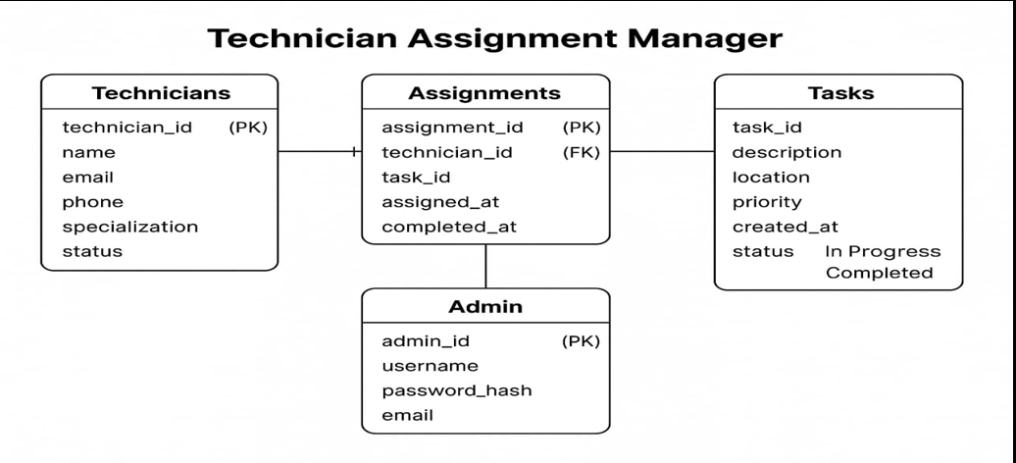
Schema Diagram Overview
Technician Service Assigning System

Slide 10

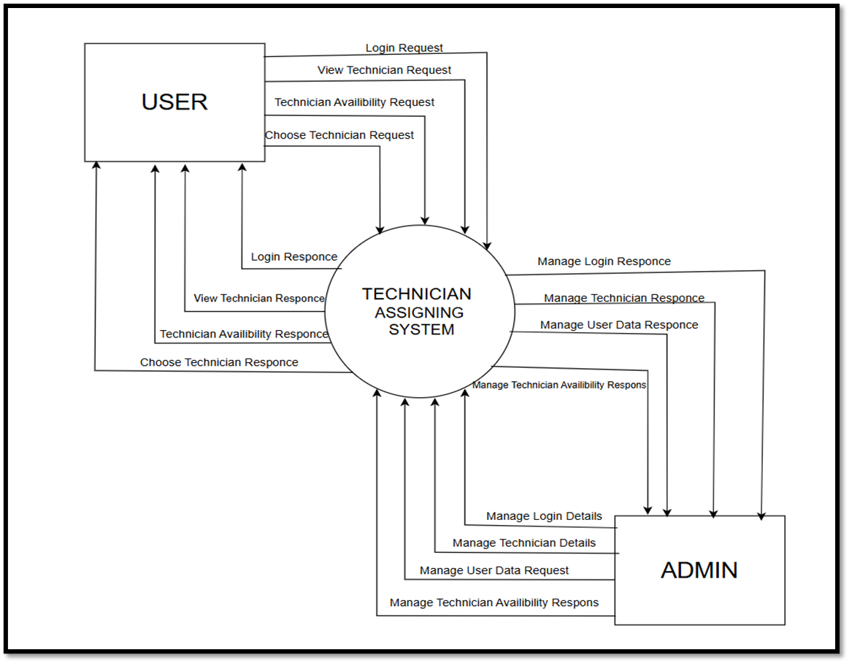
Level 0 DFD Structure
USER
Technician Service Assigning System
ADMIN

Slide 11
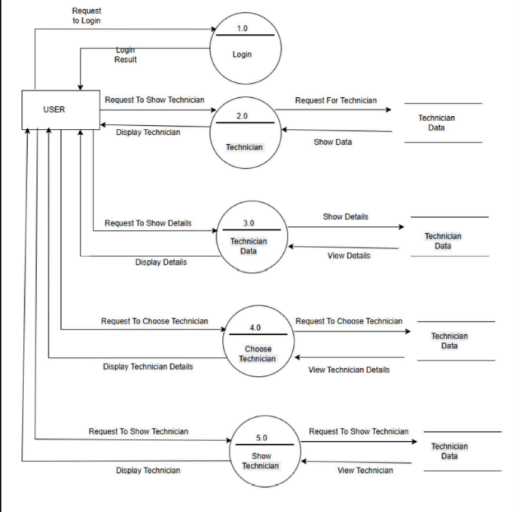
Level 1 DFD Structure :
USER PERSPECTIVE

Slide 12
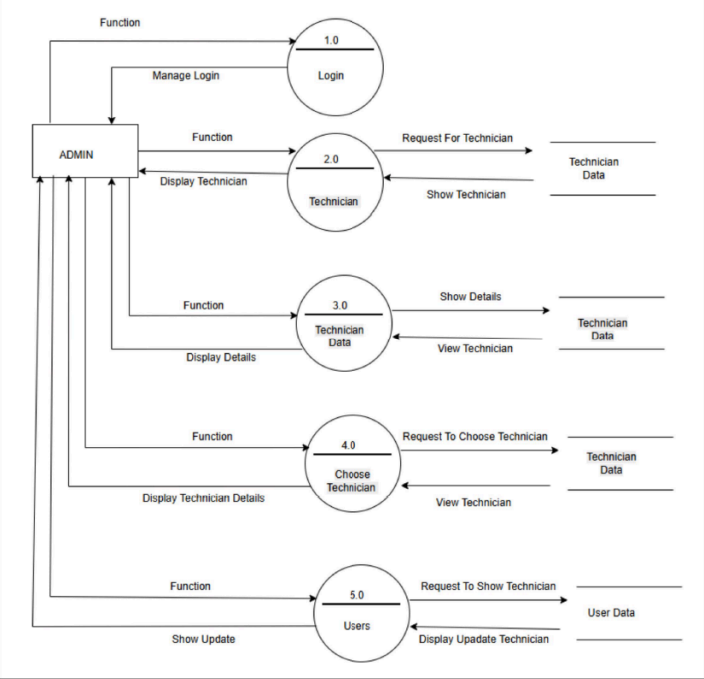
LEVEL 1 DFD STRUCTURE:
ADMIN PERSPECTIVE

Slide 13

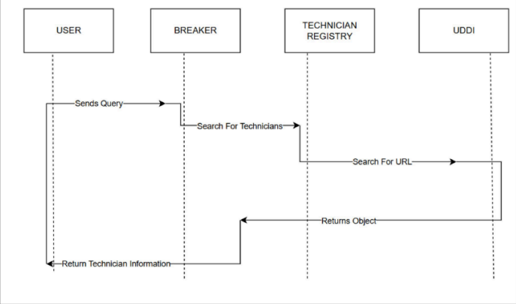
Key Elements Represented Diagram:

Slide 14
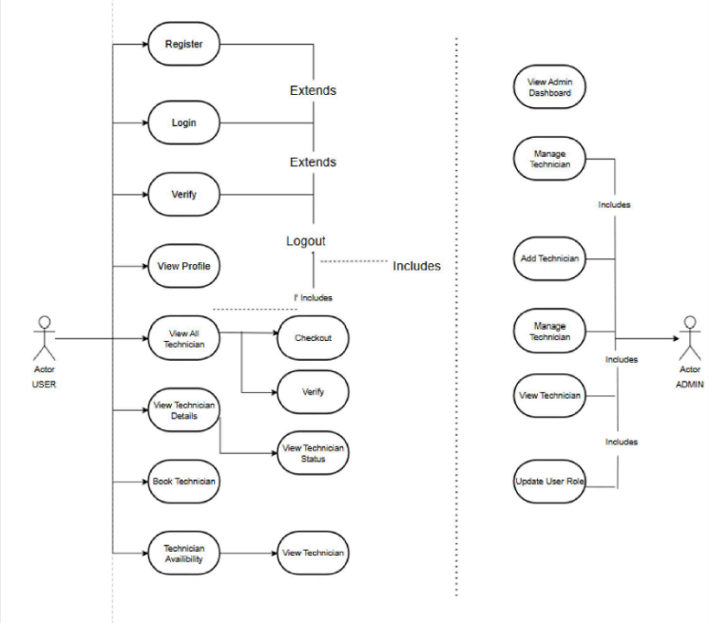
Use Case Diagram Overview

Slide 15

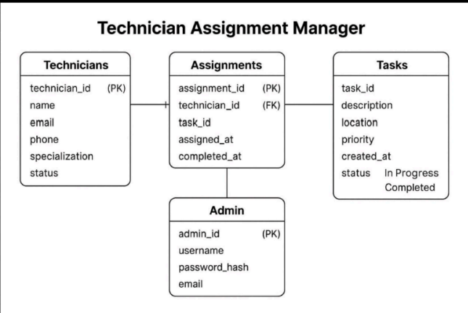
Schema Diagram

Slide 16
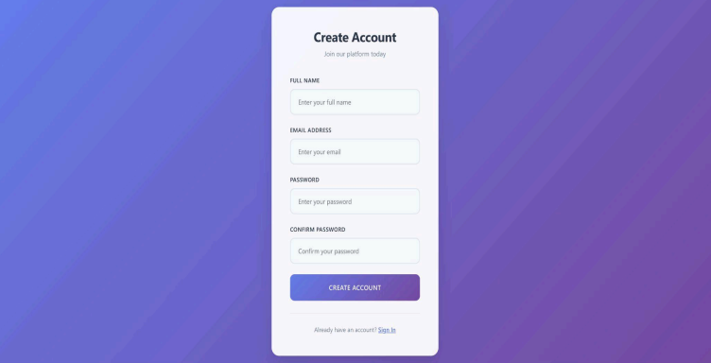
Registration Page :

Slide 17
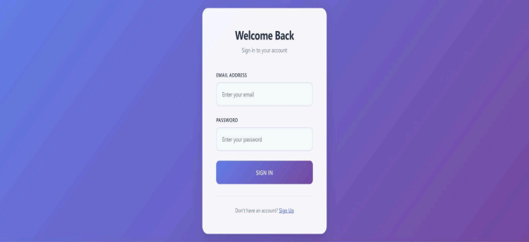
Login Page:

Slide 18
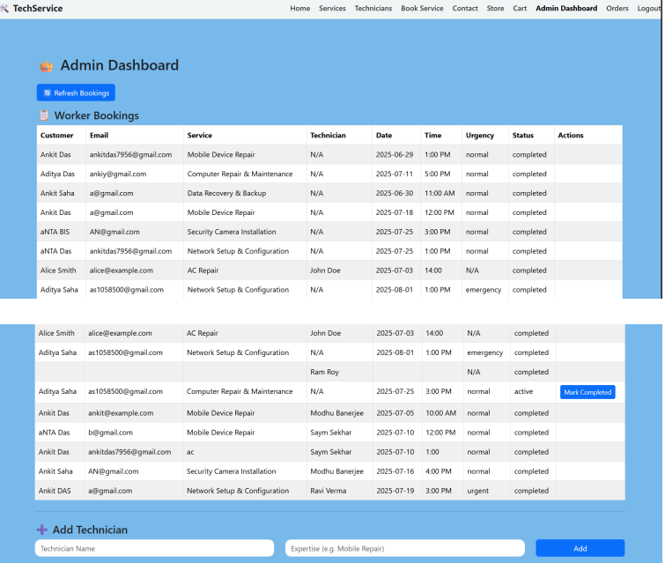
Admin Dashboard

Slide 19

Home Page

Slide 20
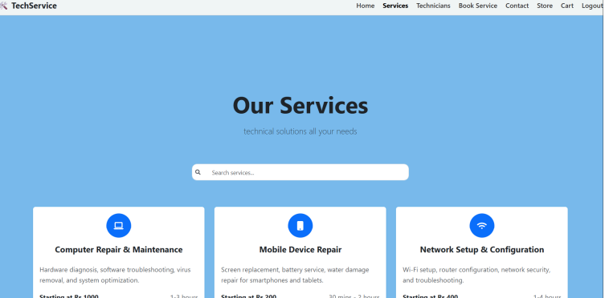
Services

Slide 21

Technicians

Slide 22
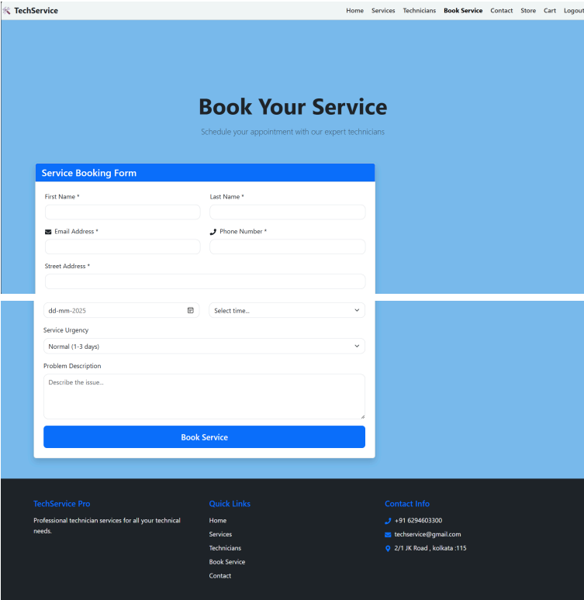
Booking Page

Slide 23
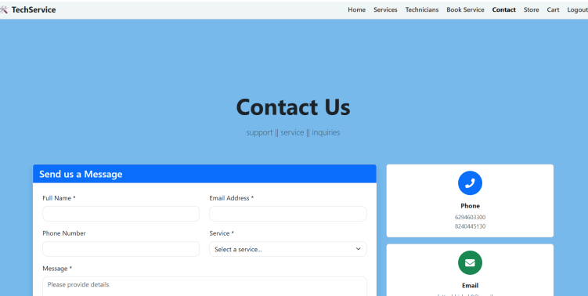
Contact Page

Slide 24
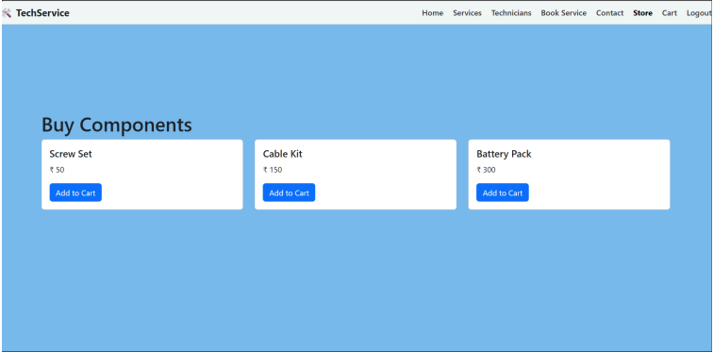
Store

Slide 25
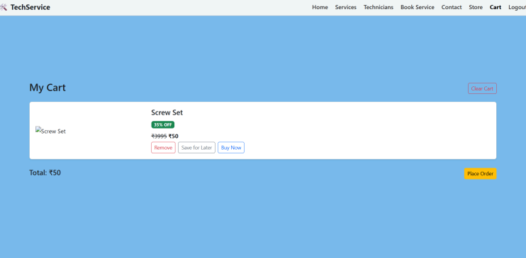
Add to Cart Page

Slide 26
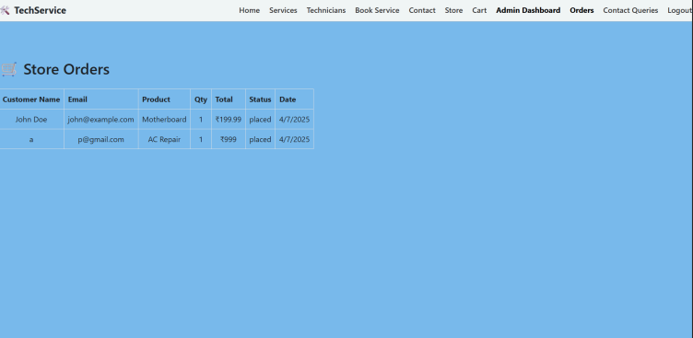
Store Order

Slide 27

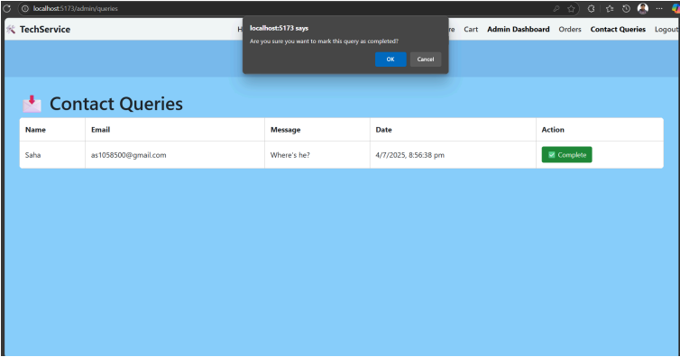
Queries page

Slide 28


Future Scope of the System
The future developments of the system are promising, with potential enhancements such as AI integration, expanded features, and market adaptability across various industries.
AI Integration
Expanded Features
Market Expansion
AI algorithms might predict service demands and optimize technician assignments.
Features like geo-location tracking and advanced analytics can be introduced.
The system can be adapted for various industries beyond its initial scope.

Slide 29



Conclusion of Technician Service Assigning System
Project Impact
Future Prospects
Final Thoughts
The Technician Service Assigning System is poised to significantly improve service delivery efficiency and customer satisfaction.
By continually evolving and integrating new technologies, the system can maintain its relevance and effectiveness.
The project represents a step forward in leveraging technology for improved service management in various industries.

Slide 30




Final Summary of The Technician Service Assigning System
Comprehensive Solution
Service Efficiency
Designed to streamline technician assignments.
1
2
Enhances service efficiency through advanced features.
Future Expansion
User-Friendly Interface
4
3
Possibilities for future expansions to meet demand.
Promotes ease of use and accessibility for technicians.

Slide 31


THANK YOU!
Abhishek Datta

